Slide 1


Intro to Xamarin
Developing cross-platform apps with C# and XAML
Dipesh Trikam & Jackie Chan

Slide 2







What is Xamarin
Visual Appearance
Behaviour
XAML
Code-Behind

Slide 3

MVVM Pattern
What
Structure for code
Why
Maintainable and reusable
When
Heavyweight programs

Slide 4
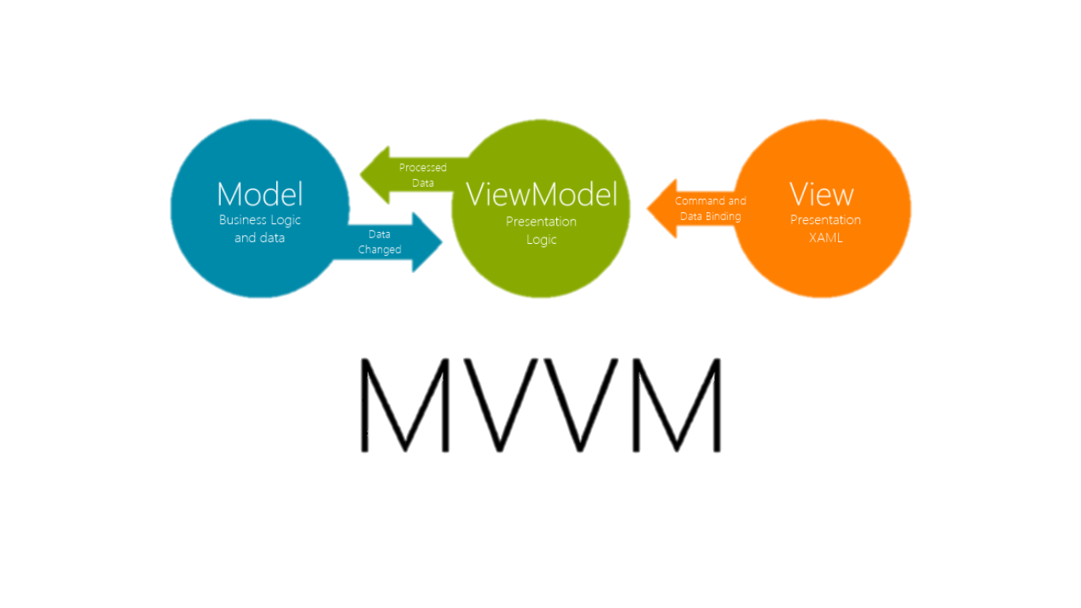
MVVM Pattern
Reference
Data Binding
Objects e.g. Buttons
Data Entities
Logic

Slide 5
Sharing Code Options
Portable Class Library
(PCL)
Shared Project
Targets platforms
Uses interfaces to provide platform-specific functionality
Uses Shared Asset Project (SAP) type to organise source code
Uses #if, #elif and #endif compiler directives

Slide 6
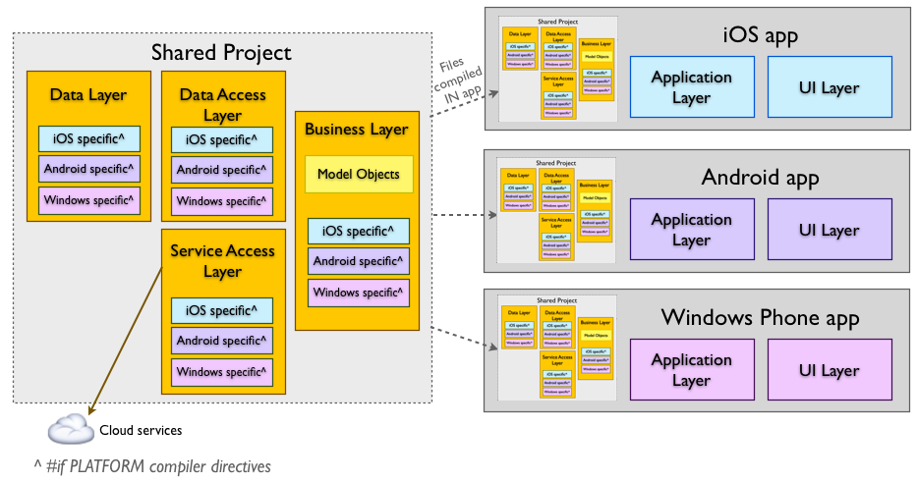
Shared Project

Slide 7
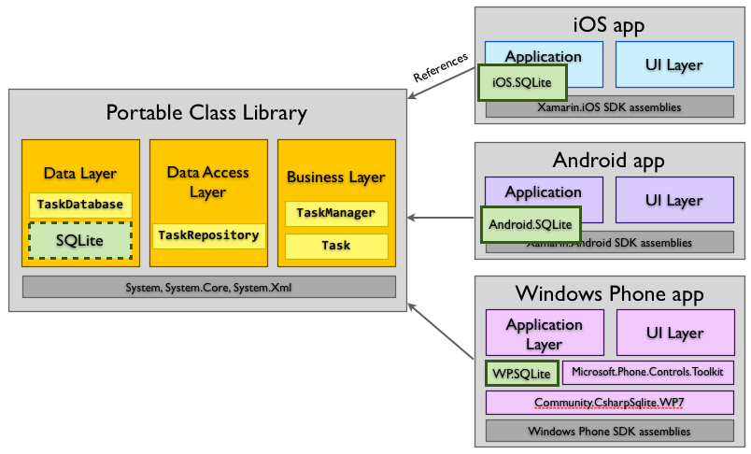
Portable Class Library

Slide 8
Platform specific code
Portable Class Library
(PCL)
Shared Project
if (Device.OS == TargetPlatform.iOS) { … }
else if (Device.OS == TargetPlatform.Android) { … }
#if __IOS__
…
#elif __ANDROID__
…
#endif

Slide 9
Thank you

